Slide 1
Approaches
Causal inference always requires us to make important assumptions. The assumptions we make by interpreting a normal predictive model as causal are however often unrealistic. Without an A/B test, conventional machine learning methods, built on pattern recognition and correlational analyses, are insufficient for decision-making
RCT
Natural experiments
Instrumental variables
Difference-in-Difference
Regression Discontinuity
Observational methods
Parametric methods / Nonparametric methods / Imputation methods
Can make some causal inferences so long as you best control for confounders and make the necessary assumptions
Do Calculus
New field of math
Combines graphs and do calculus
SEMs to create causal graphs
Includes CFA / path analysis / causal modelling with latent variables / ANOVA / multivariate regression
Library(sem)
Observed variables and unobserved latent factors
Build graphs manually using business logic (not very scalable, takes long time)
E.G. DoWhy – define confounding feaures, heterogeneous features (i.e. ones that cause different effect). DoWhy then gernates a casual graph for you..
Explicit assumptions with validity checks on these assumptions
A formal causal framework to encode domain knowledge
Runs automated robustness checks to validate the causal estimate from any estimator method
High-dimensional data increases issue of confounding
New Causal Packages
econML
CausalML
This kind of approach will create a graph having received large datasets…graphs can then be exported and tweaked manually. Uses statistical
3. Bayesian Methods (CausalNex)
- Directly model network using graphical approaches and combine with Neo4j
4. Econometrics??
N.B SHAP
explains what the model is doing, to gain faith in the model and get stakeholder buy-in and diagnose problems
It does not illustrate causal relationships between inputs and output
SHAP just makes correlations picked up by our model transparent
Unless features in a model are the result of experimental variation, applying SHAP to predictive models without considering confounding is generally not an appropriate tool to measure causal impacts used to inform policy

Slide 2
Rationale
Advantage of using Causal Inference instead of AB tests
AB test needs randomisation – sometimes cannot force people into specific cohorts ???
With causal inference can add a causal graph - by using that in addition to observational data - can emulate an AB test
ML models designed to make predictions but not lead business change
Are black boxes
Shapley gives us importance but does not say if something is causally significant
Cannot define actionable intervention
By how much do we need to change a feature, what will the outcome be, what changes are most effective
Causality requires new way of thinking that involves careful use of input feature from the get go (in contrast to just throwing everything at it and iterating until it looks correct)
Will account for confounders
To answer questions like:
Impact of price increase on individual customer behaviour
How inflation will impact churn
An increase in __ by __ would increase the avg __ by __

Slide 3
Sources
https://github.com/microsoft/EconML/blob/main/notebooks/CustomerScenarios/Case%20Study%20-%20Customer%20Segmentation%20at%20An%20Online%20Media%20Company%20-%20EconML%20+%20DoWhy.ipynb
https://github.com/microsoft/EconML/blob/main/notebooks/CustomerScenarios/Case%20Study%20-%20Recommendation%20AB%20Testing%20at%20An%20Online%20Travel%20Company%20-%20EconML%20%2B%20DoWhy.ipynb
Do calculus and python libraries
Causalinference:
https://analyticsindiamag.com/a-complete-guide-to-causal-inference-in-python/
http://www.degeneratestate.org/posts/2018/Mar/24/causal-inference-with-python-part-1-potential-outcomes/
(https://causalinferenceinpython.org)
DoWhy:
https://github.com/microsoft/EconML/blob/main/notebooks/CustomerScenarios/Case%20Study%20-%20Customer%20Segmentation%20at%20An%20Online%20Media%20Company%20-%20EconML%20+%20DoWhy.ipynb
https://medium.com/geekculture/a-quickstart-for-causal-analysis-decision-making-with-dowhy-2ce2d4d1efa9 (???)
https://microsoft.github.io/dowhy/example_notebooks/tutorial-causalinference-machinelearning-using-dowhy-econml.html (???)
https://microsoft.github.io/dowhy/

Slide 4
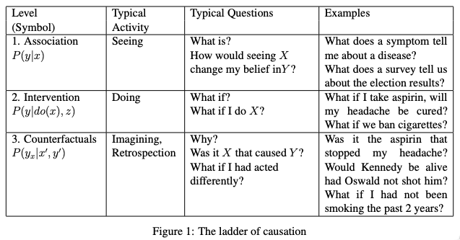
Book of Why – Judea Pearl
Can be a good approach where stakeholder knows a lot/has a lot of theories. Can then fit a model based on this and data will assign values to this
Assumes that data alone is dumb and cannot be causally interpreted
Require path diagrams and do-calculus to draw causal conclusions
Believes must choose a diagram before fitting observational data at all
Data must simply inform the pre-specified diagram by means of estimating the coefficients for each arrow between nodes
Uses path models/non-parametric SEMs (structural equation models) & DAGs as the solution to the problem of inferring causes from observational data
Argue that using path models as a tool requires that you already have a deep understanding of the domain
Is overly optimistic that may fields have set of convincing theories and background knowledge
Causality is all about understanding the data generation process
Failed attempt to overcome the messy trial and error approach of scientific discovery, with clean mathematical and overly rational logic
Could argue that a lot of the causal diagram analysis is done when building out the input feature space – do not throw everything into the model but carefully select “causal” drivers

Slide 5
Causal Terminology
Term | Explanation
Causal graph | Visual summary of the data generation mechanism
Confounder | Like an extra IV that has a hidden effect on your DV Influences both DV and IV, causing a spurious association Must be causally related DV & correlated with IV E.G. Ice cream consumption (IV) causes sun burn (DV), seems spurious. Confounding variable is temperature Must account for these to guarantee internal validity of results So always beware of unmeasured confounding variables Confounders increase variance and introduce bias
Mediator | variable that causes mediation in the dependent and the independent variables. In other words, it explains the relationship between the dependent variable and the independent variable.
Colliders
unmeasured confounding features | E.G. Customer satisfaction. Features that are known to have causal impacts in your causal diagram
Exogenous / Endogenous (econometric terms but can be used in causal analysis) | N.B. Believe it is all relative to the system/model you are considering Exogenous variable is externally determined outside of the model e.g. Interest Rate / Tax rate / Total Rainfall. Is not affected by other variables in the system + influences endogenous variables in the system + fixed when enter model Endogenous variable is determined/explained by the model itself and therefore influence by one or more of the IVs (similar to a DV)
Conditional Average Treatment Effects (CATE) | The quantitive effect on the target of increasing the treatment by one unit, conditional on our control variables
Treatment | The feature for which we are measuring the causal impact of e.g. “exercise would be the treatment, and life expectancy the target”

Slide 6
How to handle confounders
RCT – takes care of all known & unknown confounders
Restriction e.g. control for age by only measuring 30 year olds
Within subjects designs
test the same subjects each time
Anything could happen to the test subject in the “between” period so this doesn’t make for perfect immunity from confounding variables.
Matching
paired designs

Slide 7
Always determine the use case for your model?
Predictive Tasks/Models
Purely aiming to understand some probability to do some action / require some binary decision making capability. OOS generalisation is key!
If purely predictive model, then spurious relationships / unexplained correlations do not matter. So long as we can best predict an outcome
When interpreting predictive models as if they are meant to be causal, likely to stumble across spurious relationships
Predictive models implicitly assume same behaviour in the future i.e. constant correlation patterns. In causation, we often want to know what happens if behaviour changes to some outcome
Causal/Explainable Tasks/Models
Where our model determines how we should act (i.e. explainability matters) then care about how each X relates to Y. And it is no longer sufficient to know a stable correlation exists between X₁ and Y. Need also to know the counterfactual scenario, where if X₁ changed, we see a resultant shift in Y
E.G. High Sky TV errors correlated with low churn. Would suggest that increasing TV errors should reduce churn further. But TV errors just a feature of high usage!! So this recommendation would have poor consequences
So main aim is to know whether changing X changes Y, or whether it is merely correlational
Aim to draw a causal graph to better understand data generation process of interest (use domain knowledge for this)
Be wary of unmeasured confounding variables
Notes:
Source: https://shap.readthedocs.io/en/latest/example_notebooks/overviews/Be%20careful%20when%20interpreting%20predictive%20models%20in%20search%20of%20causal%C2%A0insights.html

Slide 8
Issue of regularisation in models removing causal (and more importantly actionable) features and keeping observed confounders
Model to predict if a customer is retained, y = customer churned
statistical redundancy between Ad Spend and features that influence Ad Spend. This feature redundancy means predictive model can use any of those features, even if they are not all causal. While Ad Spend has no causal effect on renewal itself, it is strongly correlated with several features that do drive renewal. Our regularized model identifies Ad Spend as a useful predictor because it summarizes multiple causal drivers (leading to a sparser i.e. regularised model), but that becomes seriously misleading if we start to interpret it as a causal effect.
Ad_Spend feature
Know it has no direct causal effect on retention
But is correlated with Last_Upgrade and Monthly_Usage, which do drive retention. Presume that if monthly_usage low or last_upgrade was a while back, will increase ad_spend on that customer. So as ad_spend increases, it does not decrease churn, it just so happens to be associated with customers who are more at risk
Ad_spend is the observed confounder here
Most models would have Ad_Spend as the single best predictor of retention because it captures so many of the true causal drivers through correlations
XGBoost imposes regularization (aka tries to choose the simplest model that still predicts well). If it could predict equally well using one feature rather than three, it will tend to do that to avoid overfitting.
Means if Ad Spend is highly correlated with both Last_Upgrade and Monthly_Usage, XGBoost may use Ad Spend instead of the causal features!
This feature of ML models (that have any form of regularisation) is very useful for generating robust predictions, but less so for truly understanding which features we should manipulate if we want to increase retention
Since nothing intuitively wrong with the conclusion that increasing ad spend increases retention, we could easily have proceeded with this finding and only learned our mistake after increasing spending on advertising and not getting the renewal results we expected
Would need to find a way to get an unconfounded estimate of the causal effect of ad spend on retention OR use heuristics to choose the correlated and more actionable features

Slide 9
2. Causal inference methods Tools for observational (i.e. observed confounders) causal inference
Useful under these two scenarios:
A) Observed confounding
Be aware of observed confounding features that may confuse our causal interpretation esp. when regularised models are used e.g. Ad Spend that are influenced by other features which are causal to our outcome
A regularisation / feature selection process will remove causal features in favour of highly associated features. Drawing a causal diagram may avoid losing these features.
Solution to deconfound our selected feature to get its true causal effect?
Double/Debiased ML (simply using EconML or CausalML packages)
DoubleML assumes unconfoundedness
1) Use a ML model to deconfound your feature of interest (i.e. Ad Spend) and then estimate the average causal effect of changing that feature (i.e. the average slope of the causal effect).
Train a model to predict a feature of interest (i.e. Ad Spend) using a set of possible confounders (i.e. any features not caused by Ad Spend)
Train a model to predict the outcome (i.e. Did Renew) using the same set of possible confounders
Train a model to predict the residual variation of the outcome (the variation left after subtracting our prediction) using the residual variation of the causal feature of interest.
If Ad Spend causes retention, then the part of Ad Spend that can’t be predicted by other confounding features should be correlated with the part of renewal that can’t be predicted by other confounding features i.e. Double ML assumes that there is an independent (unobserved) noise feature that impacts Ad Spend (since Ad Spend is not perfectly determined by the other features), so we can impute the value of this independent noise feature and then train a model on this independent feature to predict the output
econML’s LinearDML model (from econml.dml import LinearDML)
- P-value of whether that treatment has a non-zero a causal effect, correctly identifying that there is no evidence for a causal effect of ad spending on renewal (P-value = 0.85)
N.B. double ML (/any other observational causal inference method) only works when you can measure and identify all the possible confounders of the feature for which you want to estimate causal effects
If don’t know the causal graph we could still look at the redundancy in the SHAP bar plot and see that Monthly Usage and Last Upgrade are the most redundant features and so are good candidates to control for (as are Discounts and Bugs Reported)
B) Non-confounding redundancy
Where feature of interest causally drives, or is driven by, another feature included in the model, but that other feature is not a confounder of our feature of interest
E.G. “Sales Calls” directly impact retention, but also indirectly effects retention through “Interactions” feature. Including both “Interactions” and “Sales Calls” means the causal effect is shared. Thus XGBoost underestimates the true causal effect of “Sales Calls”
Solution?
Remove the redundant variables i.e. “Interactions”
Double ML fails to capture indirect causal effects if you control for downstream features caused by the feature of interest
will only measure the “direct” effect that does not pass through the other feature
However, is robust to controlling for upstream non-confounding redundancy (where the redundant feature causes the feature of interest), though this will reduce your statistical power to detect true effects
Unfortunately, rarely know the true causal graph so cannot identify redundant features relative to feature of interest because of observed confounding vs. non-confounding redundancy. If it is because of confounding then we should control for that feature using a method like double ML, whereas if it is a downstream consequence then we should drop the feature from our model if we want full causal effects rather than only direct effects. Controlling for a feature we shouldn’t tends to hide or split up causal effects, while failing to control for a feature we should have controlled for tends to infer causal effects that do not exist. This generally makes controlling for a feature the safer option when you are uncertain.

Slide 10
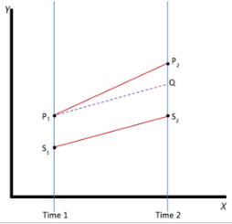
3. When neither predictive nor causal inference (i.e. unconfounding methods) can answer causal questions
Unobserved confounders can make answering causal questions with predictive models or unconfounding methods very difficult/impossible
Finding causal effects in the presence of unobserved confounding is difficult
Means important drivers are missing
unobserved confounding = where cannot measure all confounders (maybe data just not available or too expensive to measure)
Causal inference methods that assumes unconfoundedness (e.g. doubleML) only work when you can measure and identify all the possible confounders of the feature for which you want to estimate causal effects
Predictive models will poorly estimate causal effects without this confounder
Even though both features are relatively independent of all the other features in the model, there are important drivers that are unmeasured
Solutions?
A) RCT remains gold standard for finding causal effects in this context
B) Alternatively, find randomization that breaks the correlation between the features of interest (e.g. price) and the unmeasured confounders (e.g. age) – also referred to as “natural experiments”
For B) could use specialized causal tools, differences-in-differences, or regression discontinuities can sometimes exploit partial randomization even in cases where a full experiment is impossible.
Instrumental variables where we cannot randomly assign a treatment, but can randomly nudge/encourage some people towards treatment E.G. randomly sending an email to explore a new product feature / lottery for army drafting to study impact of military experience on earnings
Difference-in-difference (DID) approaches can be helpful when the introduction of new treatments is staggered across groups
attempts to mimic an experimental research design using observational study data, by studying the differential effect over time of a treatment on a 'treatment group' versus a 'control group' in a natural experiment (using panel data)
E.G. Card & Krueger min wage New Jersey vs Pennsylvania
Relies on the equal trends assumption – i.e both pops impacted similarly over time
Facilitates causal inference where randomisation not possible
Regression discontinuity approaches – eligible to treatment at sudden sharp cut-offs (e.g. qualifies for treatment where revenue >$5,000 per month)
Difference-in-Difference

Slide 11
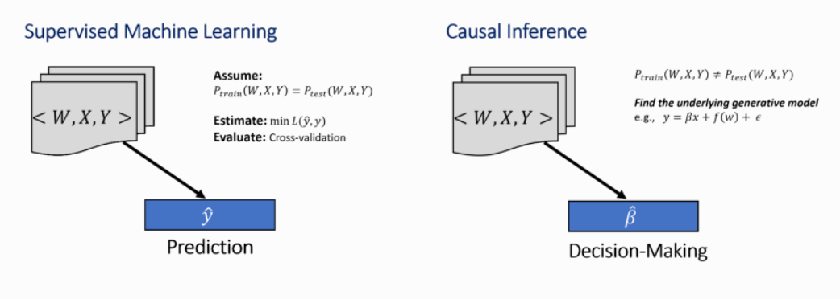
Causal Inference vs Empirical Analysis (aka ML/Supervised Learning)
Causal Inference | Empirical Analysis (Supervised ML)
For decision-making | For prediction
Tries to find underlying generative model, and thus estimate beta coefficients ?? | Tries to minimise some loss function subject to y-hat and y
Explores relationships between two observed variables
Relies on counterfactual analysis which in turns requires estimation of unobserved quantities. Forces causal inference to make assumptions about the data generation process Since there is, causal inference requires a series of principled steps to achieve a good estimator. | Makes assumptions about the data (esp. linear regression etc.) Assumes train and test are the same
No ground-truth test dataset available for evaluating counterfactual estimates (since counterfactual never existed) i.e. cannot directly calculate causal effect Thus, relies on 4 key steps to ensure a good estimator (modelling/Identifcation/Estimation/refutation) | Evaluates using test set or cross validation
Fundamental problems include: Must estimate these counterfactuals Challenge in validation
Multiple causal mechanisms can be fit to a single data distribution. Data alone is not enough for causal inference. Requires domain knowledge and assumptions | Limited generalisability of models
Causal reasoning can help build more robust ML models | ML can help in building causal effect estimators

Slide 12
Gold Standard for Causal Effect is a RCT
To estimate effect size, gold standard is a randomized experiment where a randomized subset of units is acted upon (A=1) and the other subset is not (A=0)
A random group are TOLD to take the treatment
A different random group are TOLD NOT TO take the treatment
Being TOLD is important. Cannot learn the effect of something by simply observing people that take/do the intervention vs don’t because those who independently do have done so because of a vast array of other factors in their life, which could also impact the target. E.G. Impact of kale on cardiovascular health, those who take the initiative to eat kale probably also care about other things in life that influence their health, which in turn act as confounders.
Allows you to compare real and counterfactual worlds and randomization ensures there is no systematic difference between the two subsets (“i.e. keeps everything else constant”).
However, RCT may not be possible as:
Expensive
Unethical
Time restrictions
Not enough data (also linked to time)
Instead need to rely on observational data which can be biased by correlations, unobserved confounding variables and thus systematic differences where treatment applied and not applied
E.G. Deeper discounts given to those with highest ARPU or those with lowest tenure
E.G.2 a new marketing campaign is deployed during the holiday season
E.G.3 a new feature is only applied to high-activity users
E.G.4 older patients may have been more likely to receive the new drug
Causal inference aims to remove such correlations and confounding from the data and estimate the true effect of an action

Slide 13
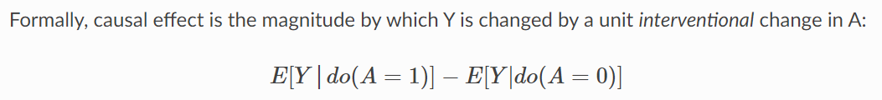
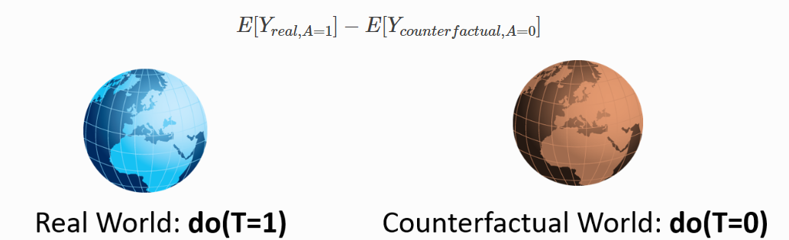
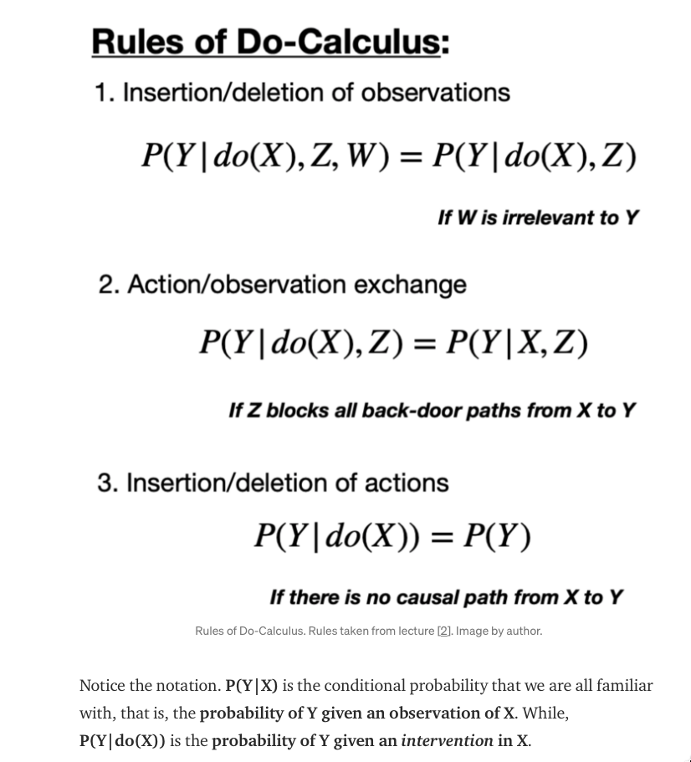
To define the causal effect, consider two worlds:
World 1 (Real World): Where action A was taken and Y was observed
World 2 (Counterfactual World): Where action A was not taken (but everything else is the same)
Causal effect is the difference between Y values attained in the real world versus the counterfactual world. A causes Y if changing A leads to a change in Y, ceterus paribus. Changing A while keeping everything else constant is called an intervention, and represented by a special notation, do(A)

Slide 14
Encode domain knowledge into a causal model (represented as a graph)
causal inference results depends largely on input assumptions, so this step is quite important
To estimate the causal effect, most common problems involve specifying two types of variables:
Confounders
Variables that cause both the action and the outcome
Any observed correlation between the action and the outcome may simply be due to the confounder variables, and not due to any causal relationship from the action to the outcome.
Instrumental Variables
special variables that cause the action, but do not directly affect the outcome
Not affected by any variable that affects the outcome
They can help reduce bias, if used in the correct way

Slide 15
Examples of data science questions that are fundamentally causal inference questions
A/B experiments: If I change the algorithm, will it lead to a higher success rate?
Policy decisions: If we adopt this treatment/policy, will it lead to a healthier patient/more revenue/etc.?
Policy evaluation: Knowing what I know now, did my policy help or hurt?
Credit attribution: Are people buying because of the recommendation algorithm? Would they have bought anyway?

Slide 16
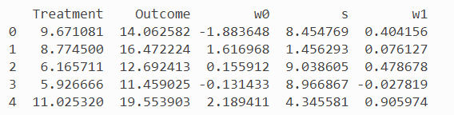
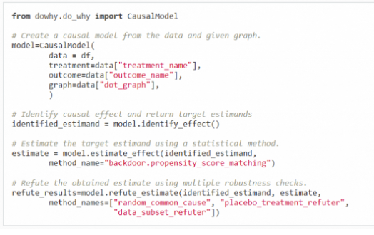
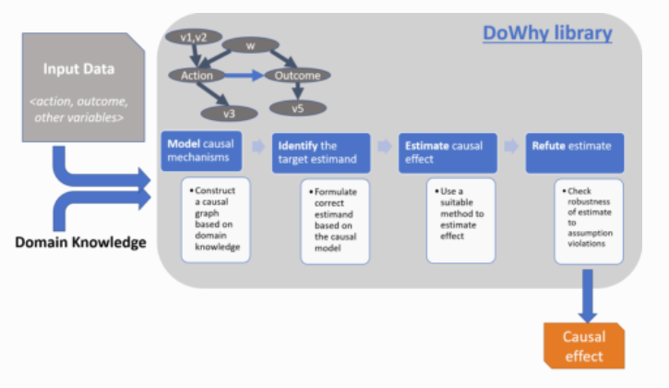
DoWhy
Treatment
This could be price / discount level / ads shown etc.
Outcome
Could be conversion / ARPU etc.
W
Represents the confounding variables
S
Represents the instrument variable
A framework for causal inference
Based on the idea of causality
Streamlines causal reasoning in ML applications
Uses Judea Pearl’s do-calculus for causal inference
Models your problem as a causal graph so all assumptions are explicit
Automatically tests for the validity of assumptions if possible and assesses robustness of the estimate to violations
DoWhy separates the identification of a causal effect from the estimation of its relevance which enables the inference of very sophisticated causal relationships
Causal Graph
i.e. need to explicity state causal assumptions and then validate them as much as possible
Has a refutation API that can automatically test causal assumptions for any estimation method, making inference more robust and accessible to non-experts
using the latest methods from statistics and machine learning to estimate the causal effect and evaluate its robustness to modeling assumptions
Models any causal inference problem using 4 key stages :
Model
Models problem using a graph of causal relationships
Identify
Based on the input graph, it will find all possible ways of identifying desired causal effect
Estimate
Estimates causal effect using statistical methods such as matching or instrumental variables
Estimation methods include propensity-based-stratification or propensity-score-matching that focus on estimating the treatment assignment as well as regression techniques that focus on estimating the response surface
Refute
Uses different robustness methods to verify the validity of the causal effect
common_cause refers to confounders

Slide 17
High Dimensional Data
Simple estimators will not estimate the correct causal effect
More advanced supervised machine learning models also do not work and often are worse than simple regression, because they include additional regularization techniques that help in minimizing predictive error, but can have unwanted effects on estimating the causal effect
Need specific methods that can estimate the causal effect + suitable refutation methods that can check the robustness of the estimate

Slide 18
Jargon
Estimand = quantity to be estimated in a statistical analysis
Y = Target variable for which we want to find the effect on
T = Treatment variable. We want to find the causal impact of this on Y
X = Control features (how does causal effect vary as a function of variables X) e.g. remaining weeks on offer / age
W = confounders (not used for splitting the population of events) e.g. Inflation
Often will control for X by stratifying population e.g. into age groups / customer life cycle etc., and then measuring the ATE of 10% increase in ATE, accounting for W
Would then use causal shapley values to visualise results in a familiar way
Thin it combines Shapley values and do-calculus
See https://proceedings.neurips.cc/paper/2020/file/32e54441e6382a7fbacbbbaf3c450059-Paper.pdf
Instrumental variable, Z
Used to account for unexpected behaviour between variables
Has causal effect on X
Affects Y only through X (i.e. no direct influence)
No confounding for the effect of Z on Y
E.G. Ability (Z) on education (X) and wages (Y)
E.G. depression (X) and smoking (Y) and lack of job opportunities (Z). Z could lead to depression, but it is only associated with smoking through its association with depression (i.e. there isn’t a direct correlation between lack of job opportunities and smoking). Z can be used if measurable and it’s behavior can be accounted for.
confounding variable
An “extra” variable that you didn’t account for
Can ruin experiments and give you useless results
Has a hidden effect on outcome
In a cause-and-effect study, a confounding variable is an unmeasured variable that influences both the supposed cause and effect.
Can suggest there is correlation when in fact there isn’t. They can even introduce bias. That’s why it’s important to know what one is, and how to avoid getting them into your experiment in the first place.
E.G. Activity level (X) on weight gain (Y), without accounting for age
Solutions to confounding variables
Random samples
Control variables e.g. only consider 30 year olds in experiment
Within subject patterns (i.e. test same subject each time)
Counterbalancing (where paired designs)

Slide 19
DoWhy library
buildS a causal model
identify the causal effect
tests causal assumptions
EconML’s DML based estimators
take the discount variation in existing data, along with a rich set of user features, to estimate heterogeneous price sensitivities that vary with multiple customer features
Then use the SingleTreeCateInterpreter
presentation-ready summary of the key features that explain the biggest differences in responsiveness to a discount
Use SingleTreePolicyInterpreter
recommends a policy on who should receive a discount in order to increase revenue (not only demand), which could help the company to set an optimal price for those users in the future

Slide 20
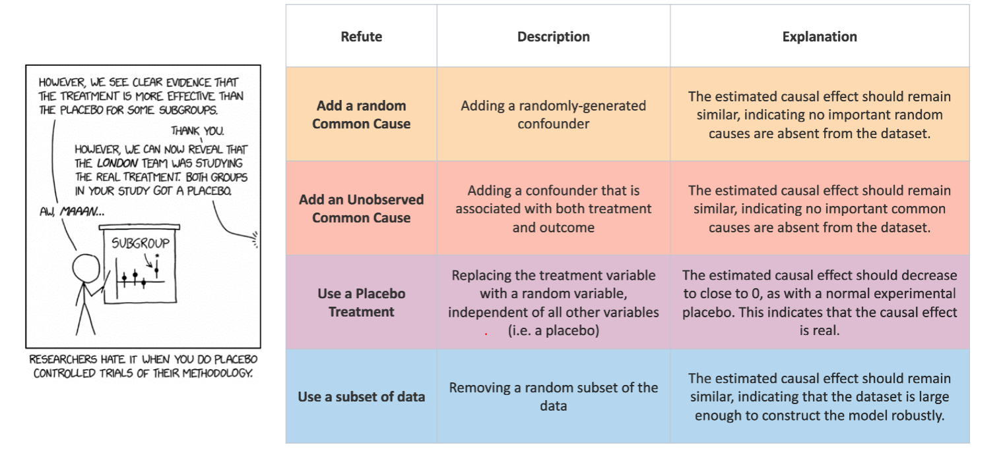
Different ways to refute a causal relationship

Slide 21
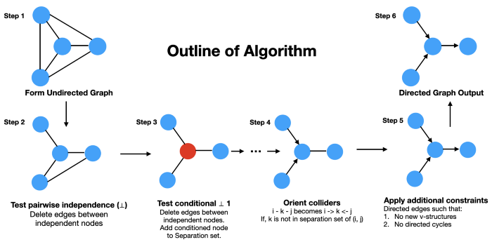
Eg: https://towardsdatascience.com/causal-discovery-6858f9af6dcb
https://towardsdatascience.com/causal-discovery-6858f9af6dcb

Slide 22
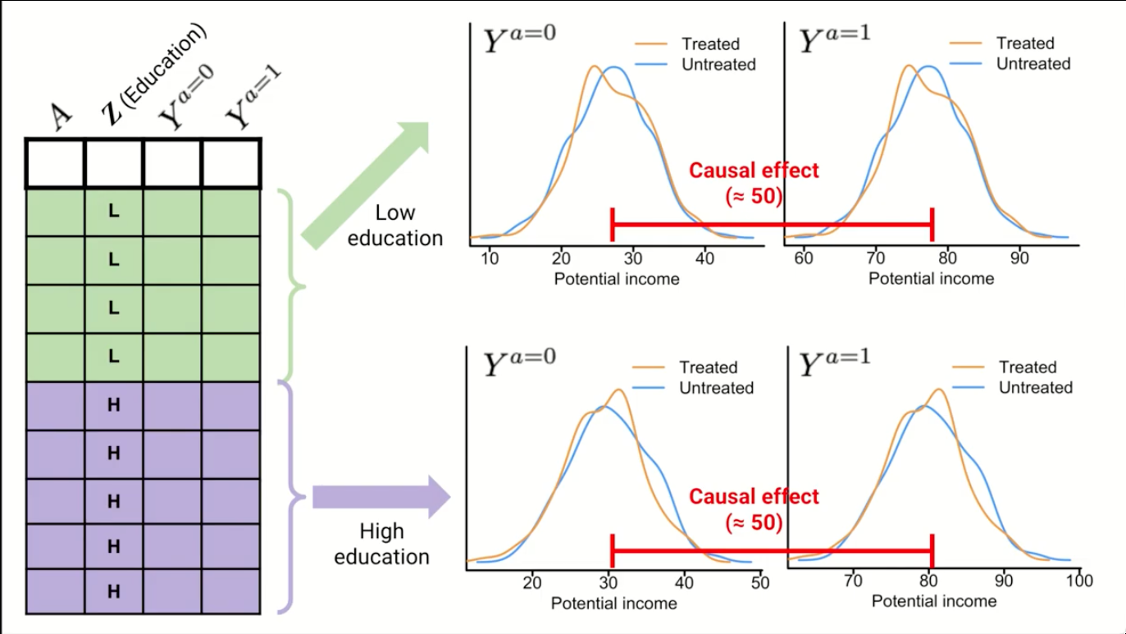
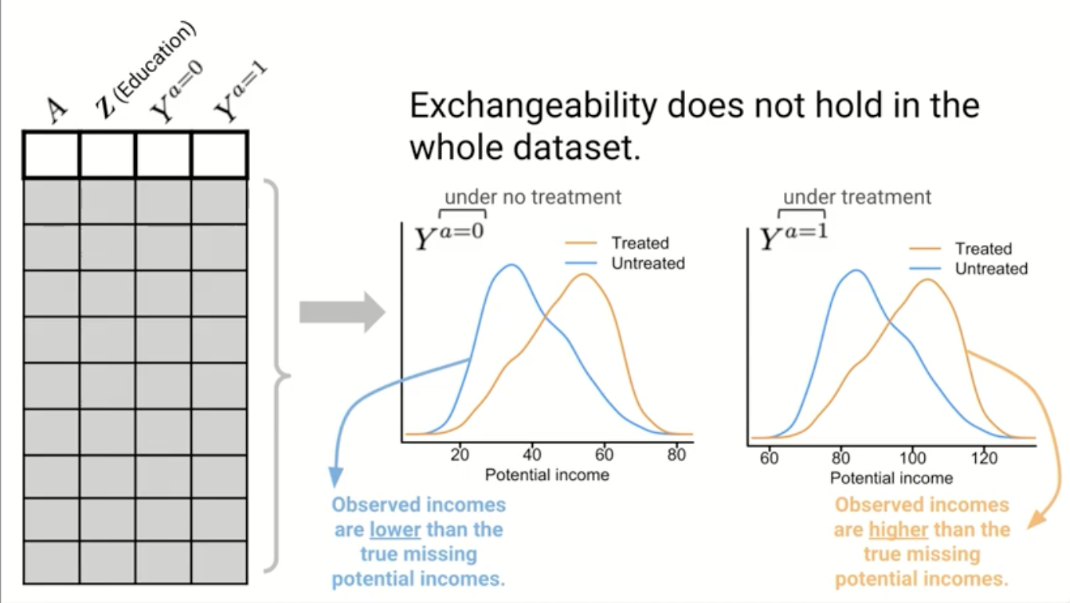
Exchangeability: stratum specific causal effect
https://www.youtube.com/watch?v=WILPl5dkMMQ&list=PLtjTgbI6JvXZ-rrZ9FOLG37IWwoyR1GcF&index=2

Slide 23
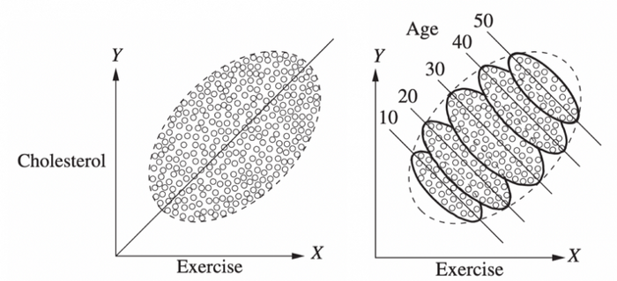
Data driven paradoxes
Simpson’s paradox and misleading data due to sampling
Magical pill very good for women, very bad for men. But terrible for population in general
I.e. effect seen in subsets of population

